Slide 1

Olist Store Analysis
Report

Slide 2
Group Members
Onkar Hadgaonkar
Shubham Pandey
Gaurav Kanere
Rutuja Gade
Anurag Gupta
Group – 06

Slide 3
Overall Project Information
The Olist Store Ecommerce database contains information about sales transactions, customers, products, and orders. It includes data such as order details, payment information, customer reviews, and delivery status. The database schema comprises tables for orders, customers, products, payments, reviews, and shipping.

Slide 4
Overall Project Objective
To assess and optimize Olist's operational efficiency, customer satisfaction, and market performance by analyzing key performance indicators (KPIs) related to weekday vs. weekend order patterns, payment statistics, delivery times for specific product categories, geographical customer behaviour, and customer satisfaction metrics.

Slide 5
KPI - 4
Average price and payment values from customers of sao paulo city
KPI - 2
Number of Orders with review score 5 and payment type as credit card.
KPI - 1
Weekday Vs Weekend Payment Statistics
KPI - 3
Average number of days taken for order_delivered_customer_date for pet_shop
KPI - 5
Relationship between shipping days Vs review scores.

Slide 6
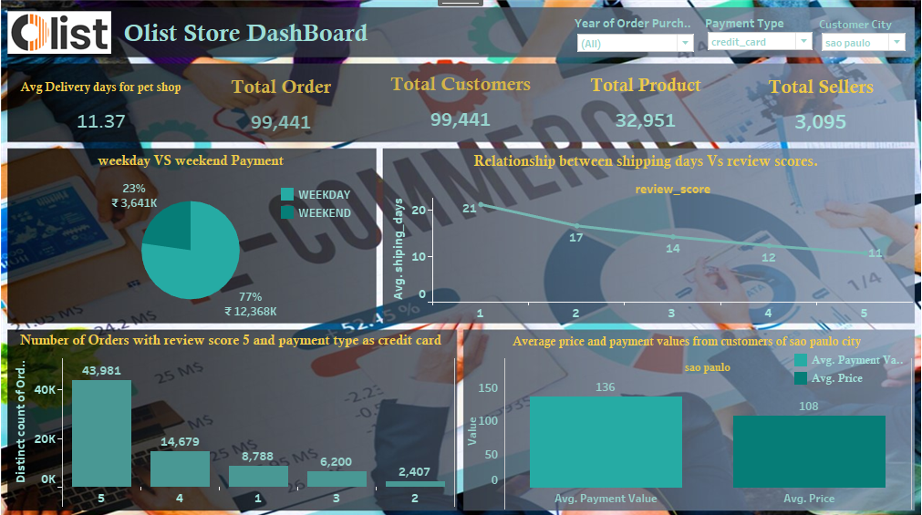
TABLEAU DASHBOARD

Slide 7
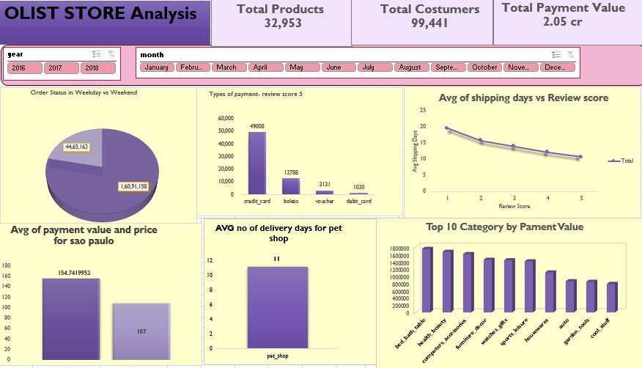
EXCEL DASHBOARD

Slide 8
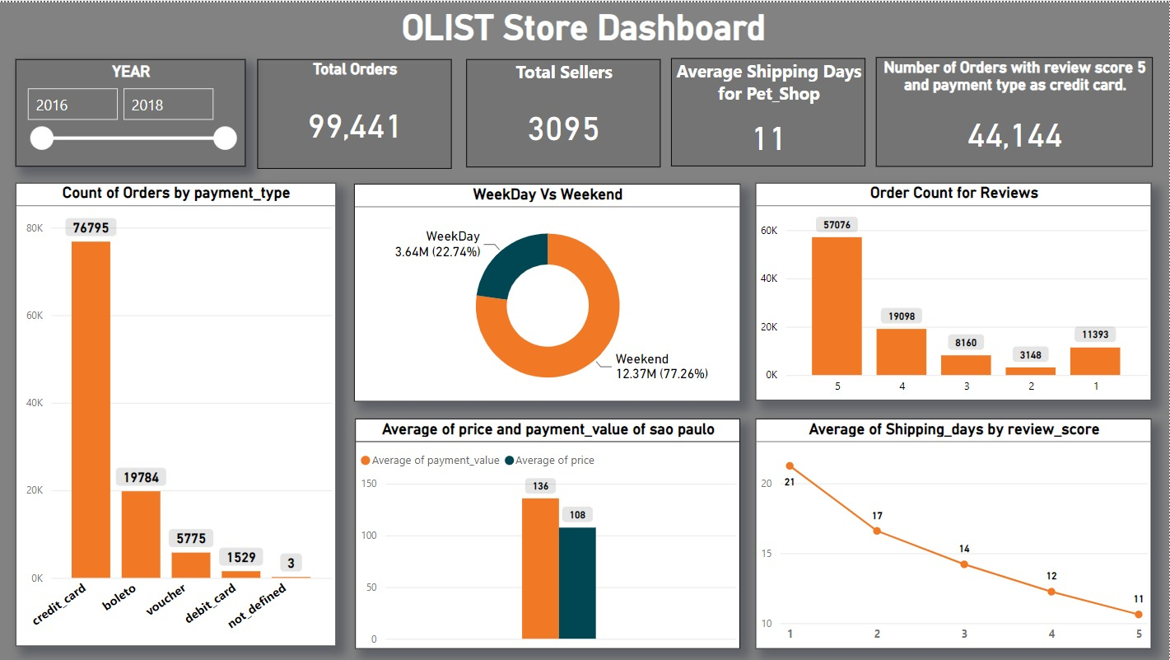
POWER BI DASHBOAD

Slide 9
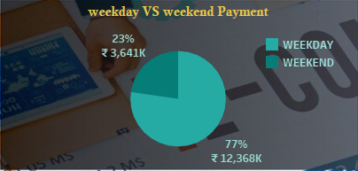
Weekday Vs Weekend Payment Statistics
From the pie chart, we can see that 77.26 % of Sales are performed on Weekdays and about 22.74% of Sales are performed on Weekend’s.

Slide 10
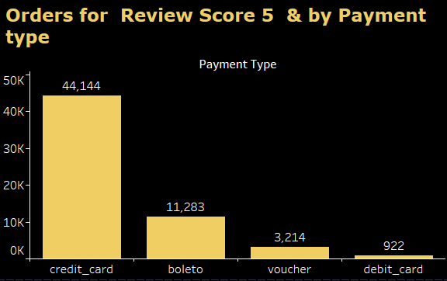
Number of Orders with review score 5 and payment type as credit card.
The Analysis reveals Number of Orders with review score of 5, which indicates high customer satisfaction among credit card users. Indicating that customers opting for credit card payments are more likely to have higher satisfaction levels.

Slide 11
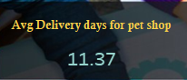
Average number of days taken for order_delivered_customer_date for pet_shop
The analysis indicates the average number of days taken for order delivery for the pet_shop category
A lower average delivery time suggests faster order processing and shipping, potentially leading to higher customer satisfaction within this product category.

Slide 12
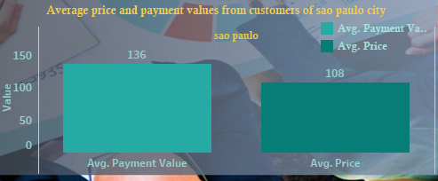
Average price and payment values from customers of sao paulo city
The Average price and Payment values can help to understand the product offerings, pricing strategies, marketing campaigns, etc. to improve the preferences and budget constraints for the customers in Sao Paulo.

Slide 13
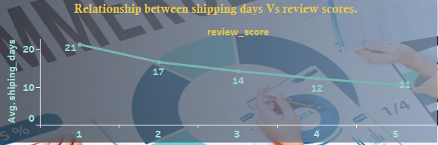
Relationship between shipping days Vs review scores.
This comparison aims to understand whether there is a correlation between the time taken for delivery and customer satisfaction levels. A shorter shipping duration may lead to higher review scores, indicating greater satisfaction with the timeliness of order fulfilment.

Slide 14
Additional Key Points for Further Analysis

Slide 15
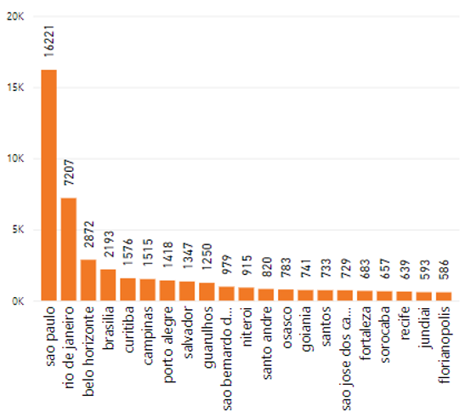
Total Orders and Sales expenses according to City
By examining this data, Olist can identify which cities contribute the most to its order volume and sales revenue, as well as understand the associated expenses incurred in these regions.
Variations in total orders and sales expenses across different cities may indicate varying levels of market demand, competition, and operational costs.

Slide 16
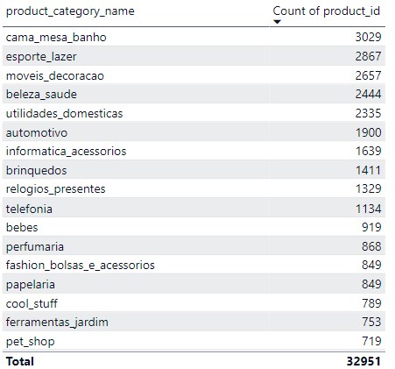
7. Products Available Under Each Category
Products Available Under Each Category
The analysis of product distribution across categories on the Olist platform reveals varying concentrations of products, with certain categories exhibiting higher representation than others.

Slide 17
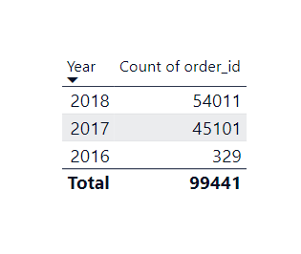
Total Orders Received According to Year
By examining this data, Olist can identify trends and patterns in order volume over time, gaining insights into the platform's growth trajectory and market dynamics.
Variations in total orders across different years may indicate shifts in consumer behaviour, changes in market conditions, or the effectiveness of Olist's marketing and promotional efforts over time.

Slide 18
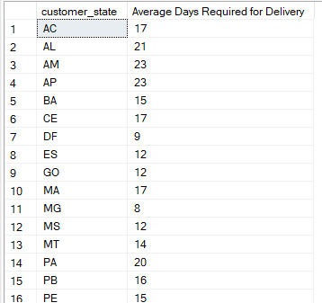
Average days required to deliver to customer according to customer State
The analysis of the average days required to deliver orders to customers according to their state provides insights into the efficiency of Olist's logistics and fulfilment operations across different regions.
Variations in delivery times between states may indicate differences in shipping distances, transportation infrastructure, or order processing capabilities, which can impact the overall customer experience.

Slide 19


